Slide 1
Baker’s Dozen
CBODN 2011
Glenda H. Eoyang, Ph.D.
Human Systems Dynamics Institute
50 East Golden Lake Road
Circle Pines, MN 55014
geoyang@hsdinstitute.org

Slide 2
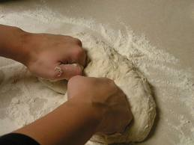
Baker Transform

Slide 3
Enjoy Your Anxiety

Slide 4
Focus a Group’s Attention

Slide 5
Explore New Horizons

Slide 6
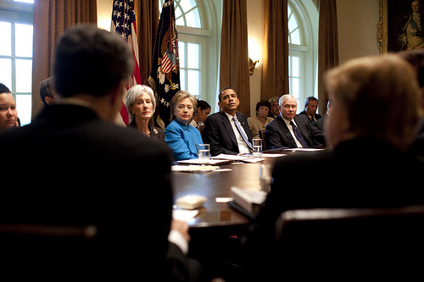
Host Effective Meetings

Slide 7
Recover from Strategic Planning

Slide 8
Coach Your Peers

Slide 9
Write Great Reports

Slide 10
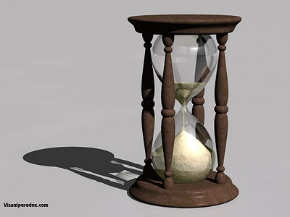
Manage Your Time

Slide 11
Set Conditions for Learning

Slide 12
Maintain your Sense of Humor

Slide 13
Design Rituals

Slide 14
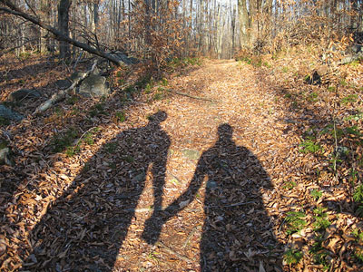
Build a Relationship

Slide 15
Stay in Shape

Slide 16
Keep from Getting Stuck

Slide 17
Your Next Stretch
How will you use stretch and fold to support your change efforts tomorrow?

Slide 18
For more information . . .
www.hsdinstitute.org
Books
Facilitating Organization Change: Lessons from Complexity Science (Olson & Eoyang)
Coping with Chaos: Seven Simple Tools (Eoyang)
Influencing Patterns for Change (Holladay & Quade)
Classes and workshops

