Slide 1


The Rise of Social Media Understanding the Past,
Exploring the Present & Projecting the Future
Terri Holley, MS CPCC
Creative Blog Solutions

Slide 2
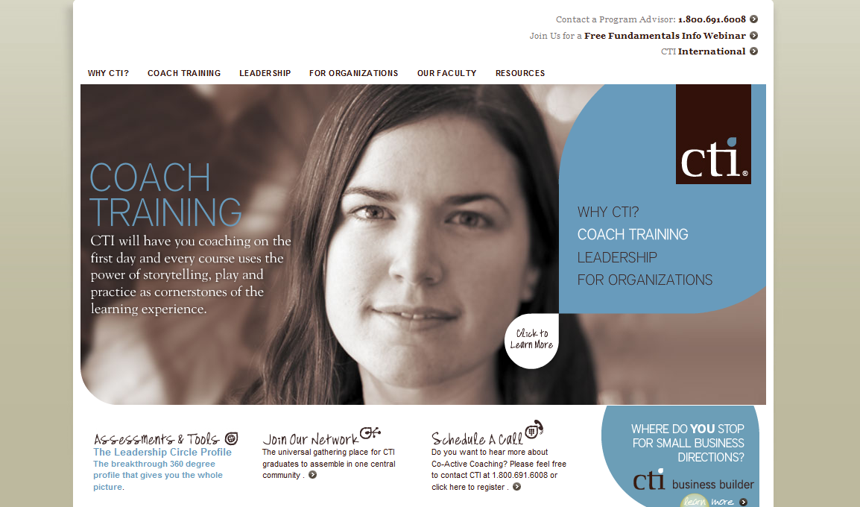
Web 2.0 Consumer

Slide 3
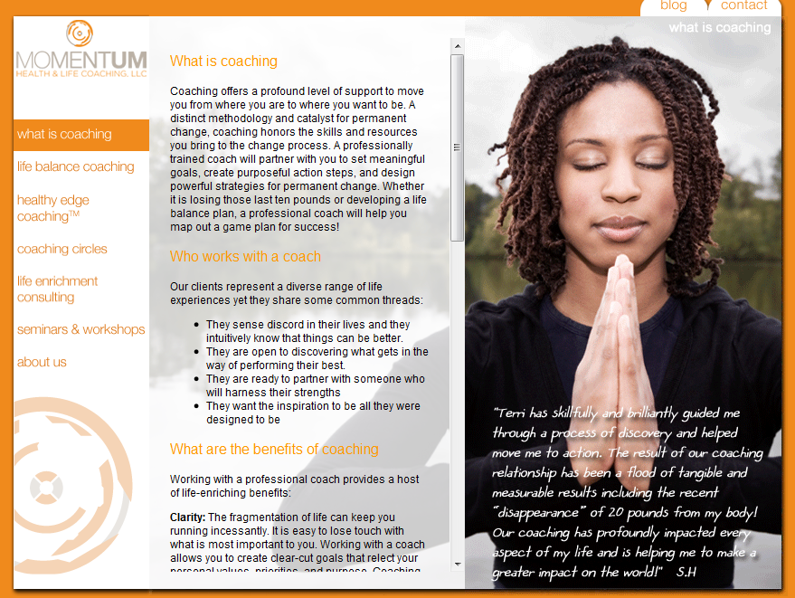
Web 2.0 Consumer

Slide 4


Slide 5

The Present
The past …

Slide 6

The Present

Slide 7
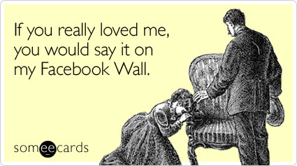

Slide 8
Social networks and blogs are the 4th most popular online activities online, including beating personal email.
If Facebook were a country, it would be the fourth most populated place in the world. This means it easily beats the likes of Brazil, Russia and Japan in terms of size.
It took radio 38 years to reach 50 million listeners. Terrestrial TV took 13 years to reach 50 million users. The internet took four years to reach 50 million people... In less than nine months, Facebook added 100 million users.
78% of consumers trust peer recommendations; only 14% trust advertisements.
By 2010 Gen Y will outnumber Baby Boomers….96% of them have joined a social network.

Slide 9

More than 400 million active users
50% of our active users log on to Facebook in any given day
The fastest growing demographic is those 35 years old and older
Average user has 130 friends on the site
More than 8 billion minutes are spent on Facebook each day (worldwide)
More than 45 million status updates each day
More than 10 million users become fans of Pages each day
Over 65% of companies incorporate Facebook in their marketing strategy

Slide 10

Yearly growth rate of 1,382%, from February 2008 to February 2009
Twitter as a part of a company’s marketing strategy has grown from 3% to 49%.
Dell announced that Twitter had driven sales worth $3 million for the organization within two years.

Slide 11

133,000,000 – number of blogs indexed by Technorati since 2002
346,000,000 – number of people globally who read blogs (comScore March 2008)
77% - percentage of active Internet users who read blogs

Slide 12
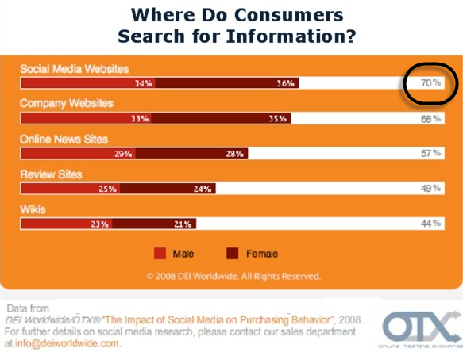

Slide 13
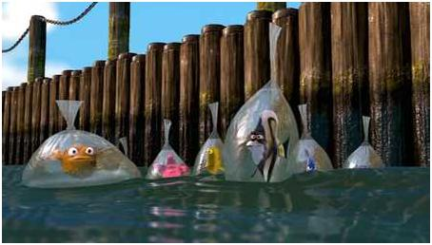
Web 2.0 Consumer

Slide 14
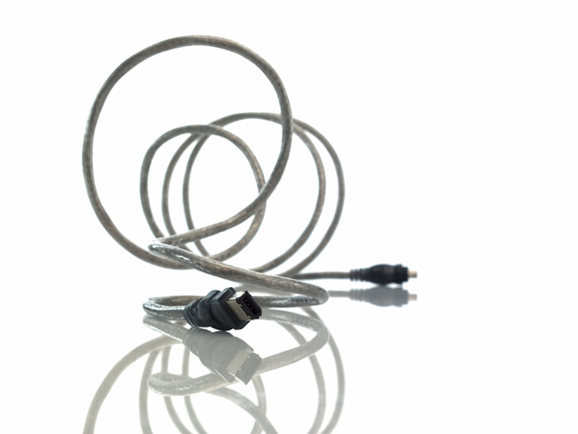
Connect with your target market

Slide 15

Establish measurable goals

Slide 16

Listen

Slide 17

Contribute to the conversations

Slide 18
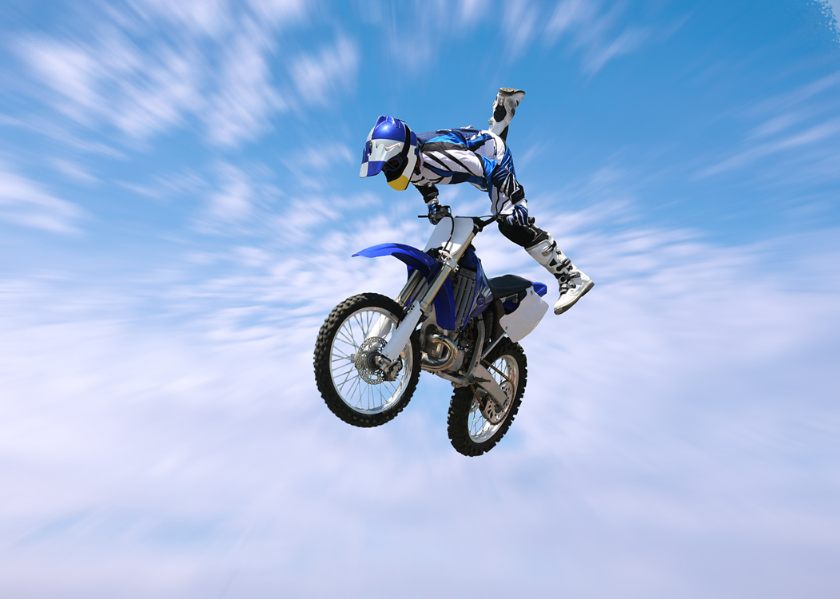
Jump in!
Jump in!

Slide 19

Being ubiquitous
Not using diverse communication mediums
Using traditional marketing methods
Low level of engagement and acknowledgement
Not turning information into actionable goals
Using social media as a strategy

Slide 20

Being ubiquitous
Not using diverse communication mediums
Using traditional marketing methods
Low level of engagement and acknowledgement
Not turning information into actionable goals
Using social media as a strategy

Slide 21
Filtering
Portability
Location-based applications
Mobile
ROI measurement
Women will rule!!

Slide 22
Ingredients for success
Brand Alignment
Compelling Core Value
Authenticity

Slide 23
www.creativeblogsolutions.com statistics: www.econsultancy.com www.forrester.com

